Slide 1
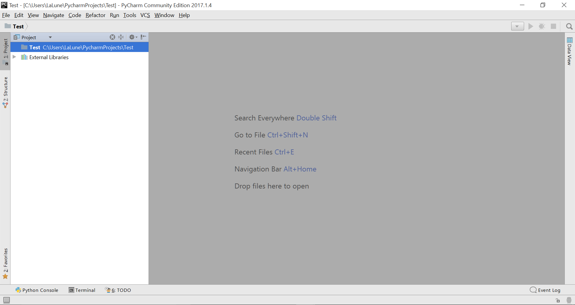

Slide 2
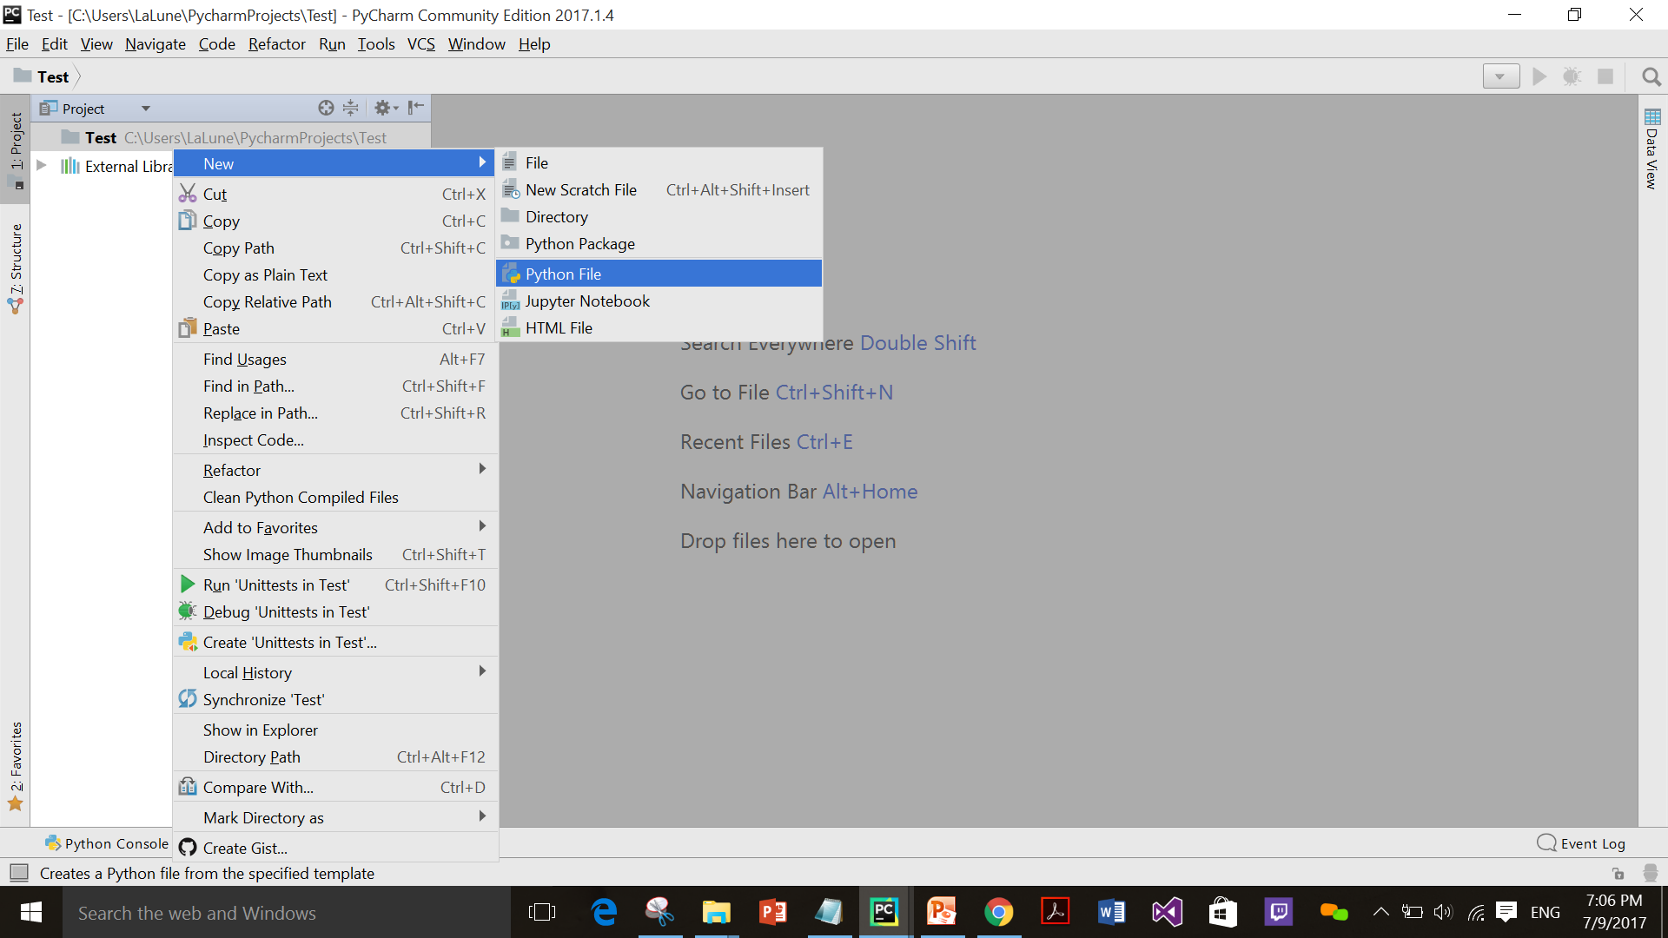

Slide 3
Bunny Tale

Slide 4
Mom’s Scenario
Mom is preparing the bunny his food
The bunny refuses to eat any carrots or lettuce anymore
He decided to wander in the forest and ask the animals to taste from their different food
The bunny will meet 5 different characters each of them will ask him some questions in order to let him taste their food

Slide 5
Cat’s Scenario
Now bunny has just met the singer kitten that was singing Twinkle Twinkle little star song.
He asks her for some fish.
She agreed but she wanted to ask him some questions about her lovely song.

Slide 6
Cat’s Q1
She wants bunny to print the the last 7 characters in her song
Cat’s Q2
She wants bunny to check if the Word Up is in her song or not
Cat’s Q3
She wants bunny to print the length of her song

Slide 7
Cat’s Scenario
After bunny’s answered all the questions the kitten gave him some of her fish but sadly he didn’t like it so he decided to go on for another food

Slide 8
Dog’s Scenario
Now bunny’s just met the sportive puppy while he was chasing butterflies, bunny asks puppy for food

Slide 9
Dog’s Q1
The sportive puppy accepts to give bunny some bones if he could print “I am jumping” 100 times.
Dog’s Q2
He then wanted him to eliminate the repetition in the list ['Duck', 'Giraffe', 'Elephant', 'Elephant', 'Duck']

Slide 10
Dog’s Scenario
Unfortunately the bones were too hard to our bunny’s teeth so he kept wandering sadly.

Slide 11
Monkey’s Scenario
Well the monkey was playing out there on the tree when the bunny passed by.
Bunny got an idea that maybe the monkey’s food is really tasteful and delicious. The monkey is so smart he definitely doesn’t eat bad stuff.
But since the monkey was so smart, his questions were all about mathematics.
Let’s help bunny to get some food.

Slide 12
Monkey’s Q1
Define a function that takes this list [10, 25, 30, 7, 11]
Find its max , min , sum and avg
Return the result, unpack the result tuple, eventually print it down.
Monkey’s Q2
Use the math package to print the factorial of 6
Monkey’s Q3
Use the math package to print the the square root of 64

Slide 13
Monkey’s Scenario
Monkey saw that bunny deserves to take 4 of his bananas.
Bunny thanked Monkey but you know what? he’s not used to eat bananas! :(
He let them away and kept going.

Slide 14
Fox’s Scenario
Bunny saw the fox lying taking a nap.
He excuses him to share him his food today.
The fox had no problem he just wanted bunny to do him a favor.

Slide 15
Fox’s Q1
I just need to call my mother to net get worry about me.
Prepare a dictionary of the contacts and print calling when you query my mom’s number
Fox’s Q2
I want to visit these cities in alphabetical order ["Moscow", "Marrakesh", "Las Vegas", "Toronto", "Shanghai", "Copenhagen”] Can sort them for me?

Slide 16
Fox’s Scenario
After then the fox offered bunny some insects.
Bunny really got disgusted and left the fox starving.
Now bunny is crying in the forest and felt so wrong.

Slide 17
Lion’s Scenario
Bunny found a lion roaring and saying I’m the king of you all!
Bunny asked the king to give him some food
The lion asked bunny about his name and his home.
He found him so weak so he started chasing him.
Now bunny’s running to escape from the king. He went back home asking for carrots and lettuce.

